Slide 1
Content Monetization Modeler
Mohan raj
Sr Component Engineer

Slide 2
PROJECT OBJECTIVE
Develop a Regression–based predictive model to accurately estimate YouTube ad revenue for individual videos using performance and contextual metrics.
Integrate the trained model into an interactive Streamlit web app for real-time revenue forecasting and data-driven content strategy

Slide 3
SCOPE OF WORK
The project involves data preprocessing, feature engineering, and exploratory data analysis (EDA) to prepare the dataset, followed by model training and evaluation using regression metrics (R², RMSE, MAE).
Finally, the optimized model will be deployed in a Streamlit application with visual analytics for interpreting revenue predictions and identifying key performance drivers.

Slide 4
TOOLS & TECHNOLOGIES
Programming & Data Processing
Python – Core programming language for data analysis and modelling.
pandas – Data manipulation, cleaning, and transformation.
scikit-learn – Machine learning, imputation (KNNImputer), and predictive ML modelling.
Data Visualization & Reporting
Matplotlib & Seaborn – For exploratory data analysis and static visualizations.
Data Storage & Management
SQL – For scalable data querying and integration.
Deployment
Streamlit - lightweight web server + a React frontend to turn scripts into interactive web apps.

Slide 5
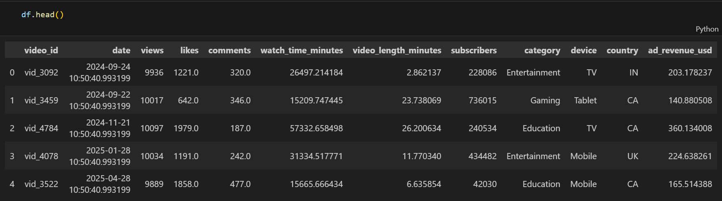
DATA EXTRACTION AND DATAFRAME CREATION
Data extraction is done locally by read comment for the CSV. File
Extracted data is validated for there “dtype “,” non-null count”,” column”
If duplicate are found same is removed from the DF
Then the cleaned data is stored to the ‘MY SQL”

Slide 6
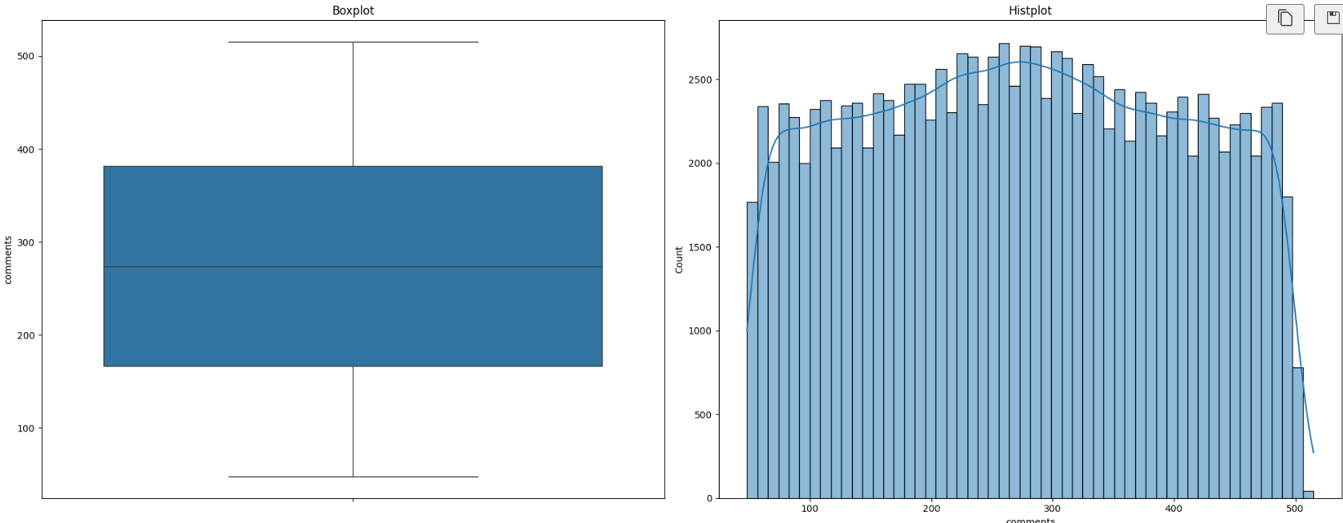
EXPLORATORY DATA ANALYSIS (EDA)
likes- Missing values which was handled by KNN imputation with neighbors 5
Comments- Missing values which was handled by KNN imputation with neighbors 5 however told KNN imputation to use the neighbors' columns for imputation

Slide 7
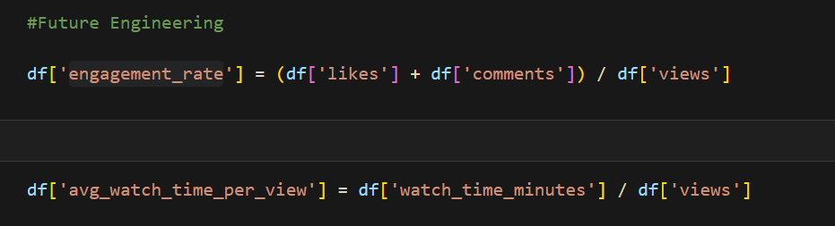
EXPLORATORY DATA ANALYSIS (EDA)
Future Engineering:
Converting "date" which consists of Dtype "datetime64" for the StandardScaler for Numerical columns
Created a column “engagement_rate” & “avg_watch_time_per_view”

Slide 8
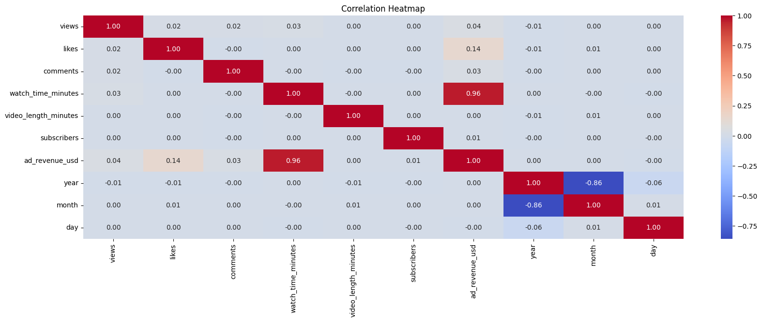
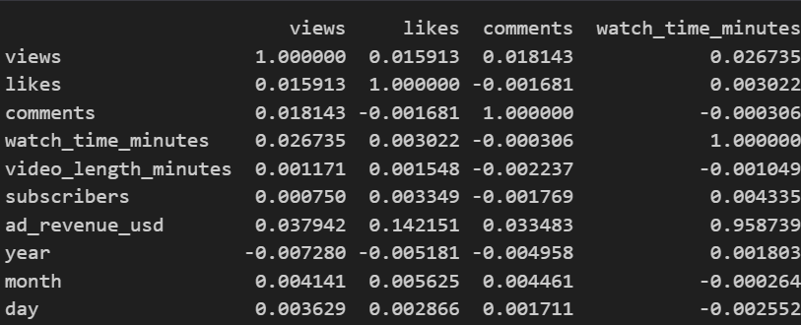
EXPLORATORY DATA ANALYSIS (EDA)
Correlation Heatmap

Slide 9
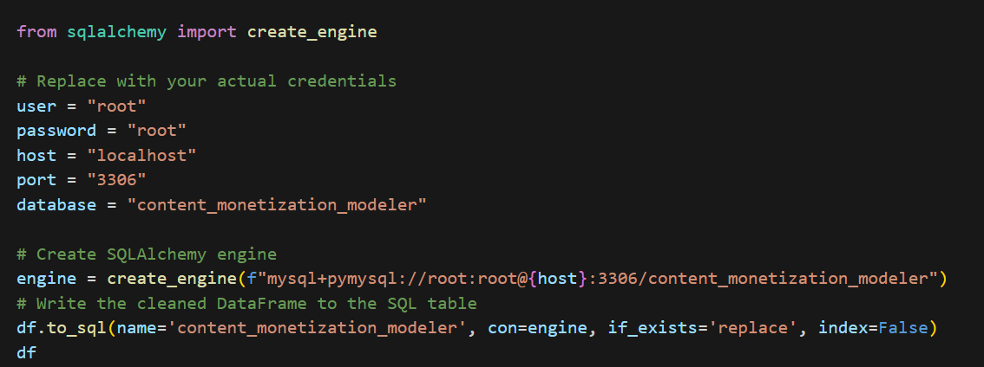
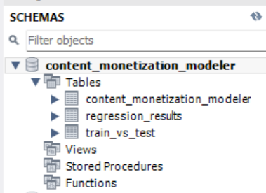
SQL DATABASE AND TABLE CREATION
Set up a connection between your cleaned DataFrame and MySQL database using ‘sqlalchemy’s ‘
Define MySQL credentials
Creates A connection engine that lets pandas or sqlalchemy's talk to your MySQL database.
Create a database in my SQL with the name “content_monetization_modeler”
Finally moved the created DataFrame to ‘My SQL’ under the database “content_monetization_modeler”

Slide 10
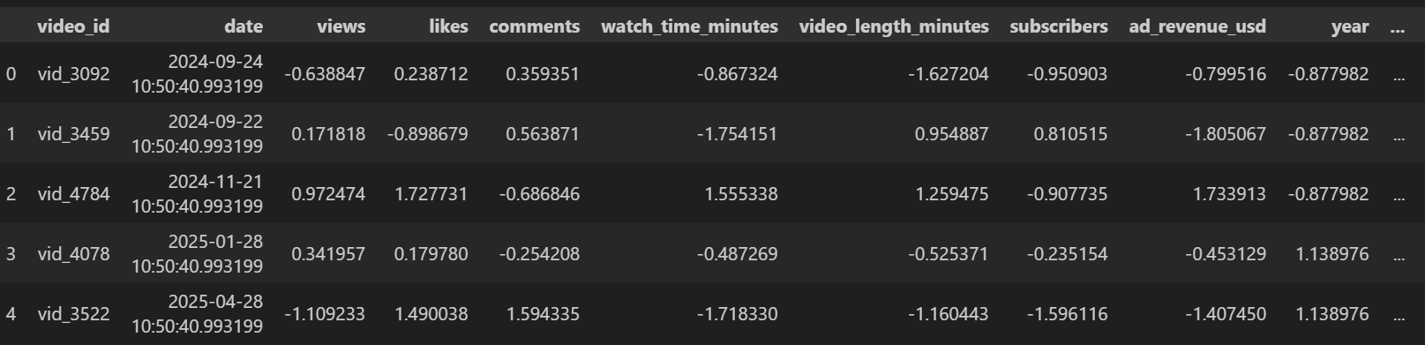
EXPLORATORY DATA ANALYSIS (EDA)
StandardScaler for Numerical columns
One‑Hot Encoding for categorical columns

Slide 11
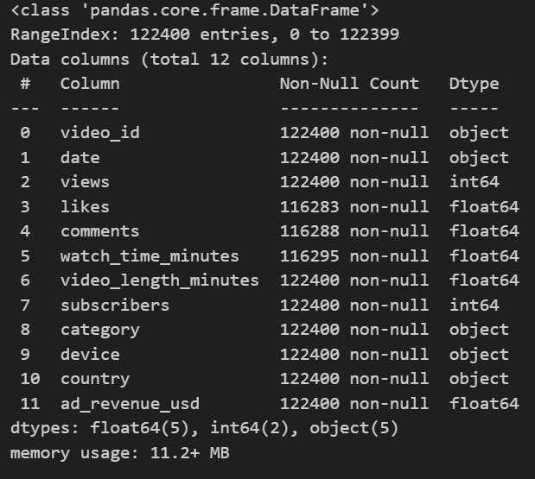
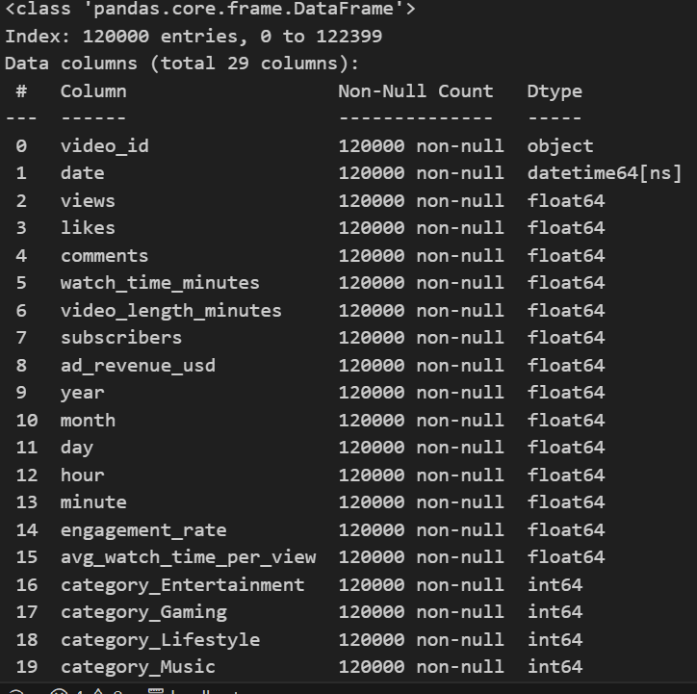
EXPLORATORY DATA ANALYSIS (EDA)
“DataFrame” (before EDA & preprocessing)
“DataFrame” (after EDA & preprocessing)

Slide 12
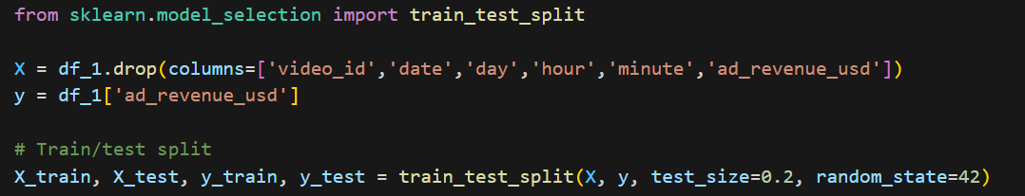
ML Mode
Train/test split:
Dropped some of the columns which are not required for the Train and testing
Test size is set at ‘0.2’ meaning 20% data will be used to test and remaining 80 % data will be used to train the model

Slide 13
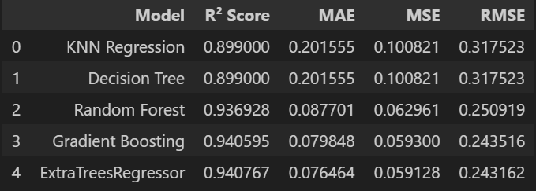
ML Mode
List of Model
Evaluation Metric
KNN Regression
Decision Tree
Random Forest
Gradient Boosting
ExtraTreesRegressor
Note: linear regression is not implemented since most of the data seem to have non-linear relationship –This will impact the model and results

Slide 14
ML Model-Metrics Summery
Model | R² Score | RMSE | Remarks
KNN Regression | 0.899 | 0.318 | Moderate accuracy, higher error
Decision Tree | 0.899 | 0.318 | Same as KNN, limited learning depth
Random Forest | 0.937 | 0.251 | Strong performance, low error
Gradient Boosting | 0.941 | 0.244 | Excellent accuracy, slightly better than RF
Extra Trees | 0.941 | 0.243 | Best performer, stable and precise predictions

Slide 15
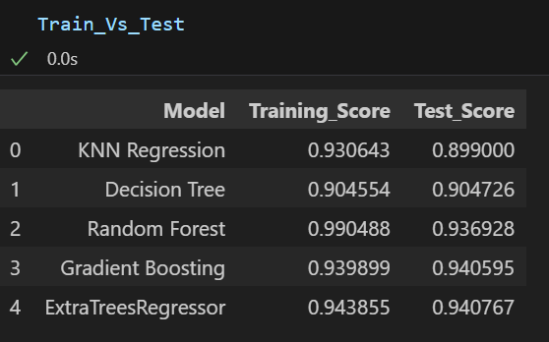
ML Model- Train Vs Test
Model | Training Score | Test Score | Remarks
KNN Regression | 0.93 | 0.90 | Slight underfitting — decent but can be improved
Decision Tree | 0.90 | 0.90 | Balanced but limited accuracy
Random Forest | 0.99 | 0.94 | Excellent fit, minor overfitting
Gradient Boosting | 0.94 | 0.94 | Very stable and well-generalized
Extra Trees | 0.94 | 0.94 | Best balance — high accuracy with minimal overfitting

Slide 16
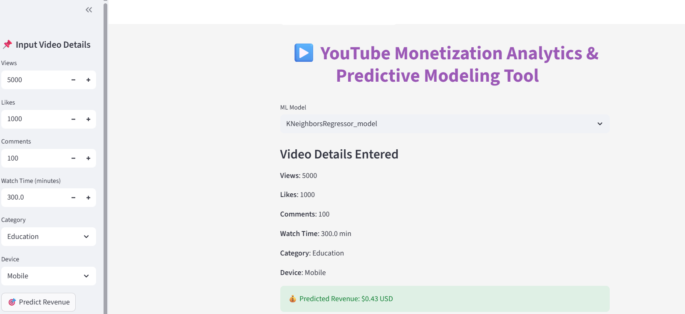
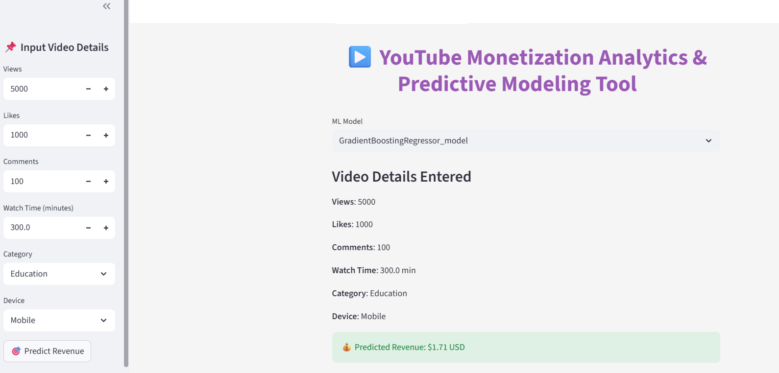
Streamlit Visualization

Slide 17
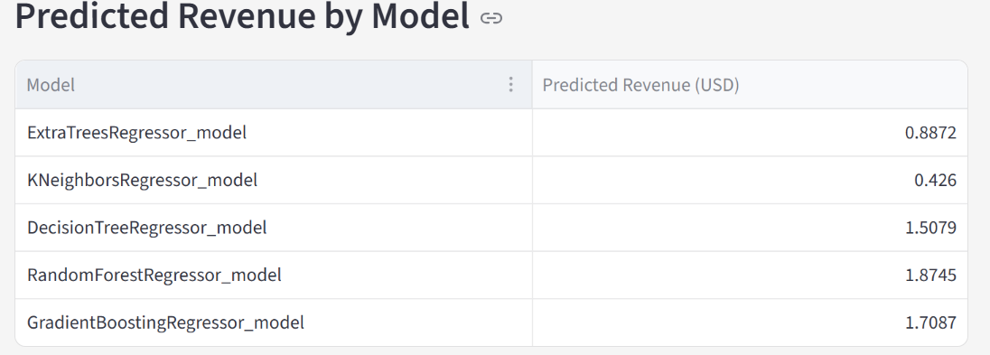
Conclusion
The predicted revenue varies widely across models (from $0.43 to $1.87).
KNN gives the lowest revenue prediction
Random Forest gives the highest prediction, which may be over-optimistic due to overfitting.
ExtraTreesRegressor and Gradient Boosting give balanced, realistic estimates, with ExtraTrees being more stable and less likely to overestimate revenue.

Slide 18
Thank you

